Slide 1
NEA
Analysis

Slide 2
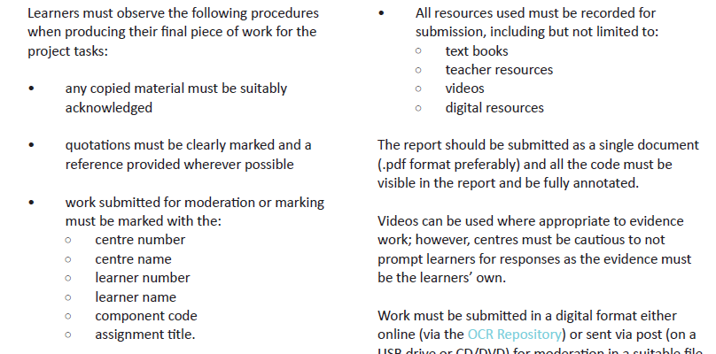
Presenting the project

Slide 3
Analysis includes …
how to analyse and identify the requirements for a solution to the problem
how to set clear objectives that show an awareness of the need for real world utility
how to use abstraction and decomposition to design the solution to a problem
how to identify the data requirements for their system
how to identify test procedures to be used during and after development to check their system against the success criteria
how to use validation to ensure a robust solution to a problem

Slide 4
Task 1 – Abstraction
Using the NEA task sheet, write an outline of the problem you have been asked to solve.
This outline should state the main points and strip out any irrelevant detail.

Slide 5
Task 2 - Requirements
List the main requirements of the solution i.e. what it has to do.

Slide 6
Task 3 – Decomposition
Consider how the problem might be broken down into separate sub-problems.
Make a list of the sub-problems and explain what each is.
Make a list of the requirements needed for each sub-solution to function
E.g. setting up a customer account
Allows user input for each field
Applies validation to appropriate fields?
Generates a unique username?
Stores the data in an array / a …. ?
Writes the data to a file

Slide 7
Task 4 – Success Criteria
Write a list of success criteria for the overall solution
Success criteria should be measureable i.e. things that you can check at the end of the project and judge either “Yes” you achieved them or “No” you didn’t.
It doesn’t matter if you don’t achieve all success criteria you initially list as you can explain why in your evaluation section
Success criteria should be about what the solution should do / should contain
Success criteria generally start with a verb e.g.
The solution must:
Allow a user to input account details without error
Generate a unique username for each new account holder
Store account information in a text file

Slide 8
Task 5 – Inputs & Outputs
You need to ensure that any opportunities for creating erroneous data within your solution are reduced
Make a list of all the inputs and outputs required for the solution together with any validation techniques that will be applied in order to reduce chances of error.

Slide 9
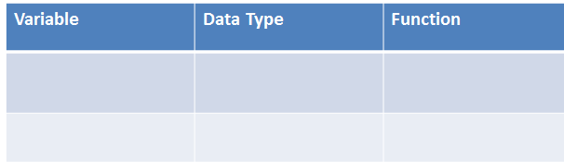
Task 6 - Data
Try to make a list of all variables and data structures that you will need to use to store items of data within the solution
For each variable / structure try to give it an appropriate name, a data type and an explanation of its function e.g.

Slide 10
Task 7 – Test Strategy
You will be testing your solution during development and after completion.
You need to produce a test plan that will list all of the tests that you plan to carry out together with a list of expected outcomes.
This plan should show that you are aware of all of the problems that could arise when the program is used by another user e.g. a test could check that data has actually been entered and is within the expected range.

Slide 11
Task 7 – Test Strategy
Use the table below to help you to set up a test plan.
You will probably keep thinking of tests to add to this as you start to develop your solution.
Test Number | Test Data | Expected Result | Actual Result | Type of Test
1 | 3 | 9 |  | Valid or in range test
2 | 1 | 1 |  | Boundary test
3 | 10 | 100 |  | Boundary test

Slide 12
Testing Types
Valid test: ensures that the correct result will be produced with the expected data
Boundary test: where the highest or lowest acceptable numbers are entered; these check any logical errors that may be have been introduced using comparison operators such <= and >=
Erroneous test: data that should be rejected is deliberately input to check that authentication routines are functioning as expected.

